Slide 1


Robrix
Kevin Boos
Tech Lead, Project Robius
Futurewei Technologies
October 17, 2024
A pure Rust multi-platform app for chat and beyond

Slide 2
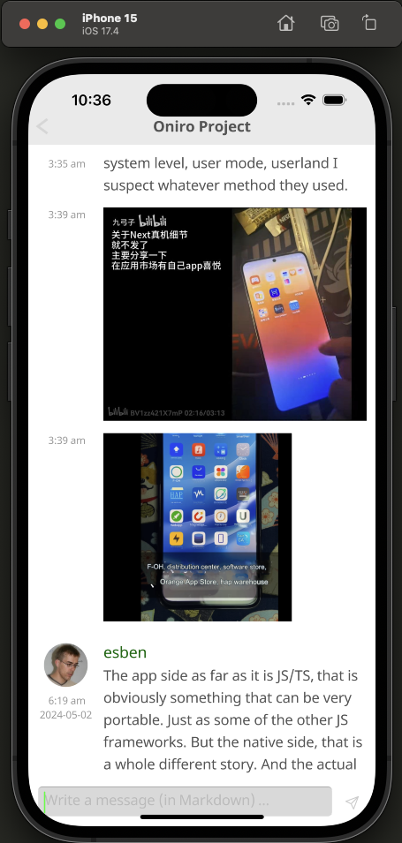
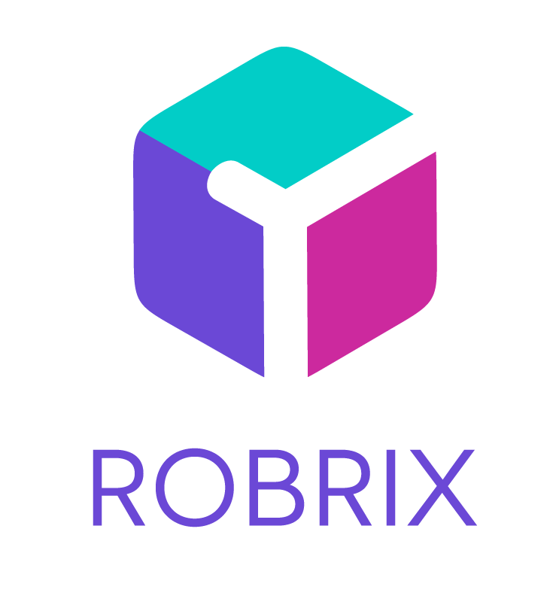
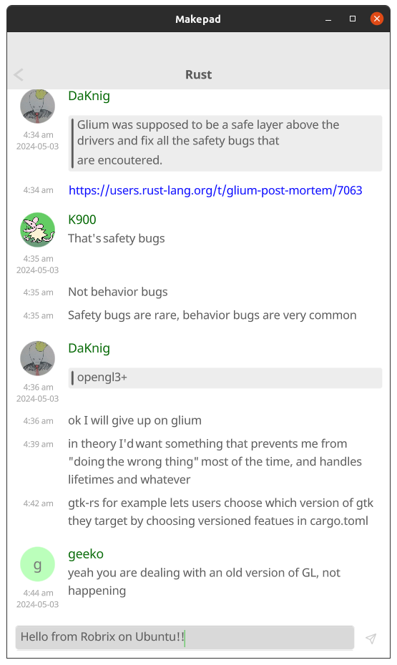
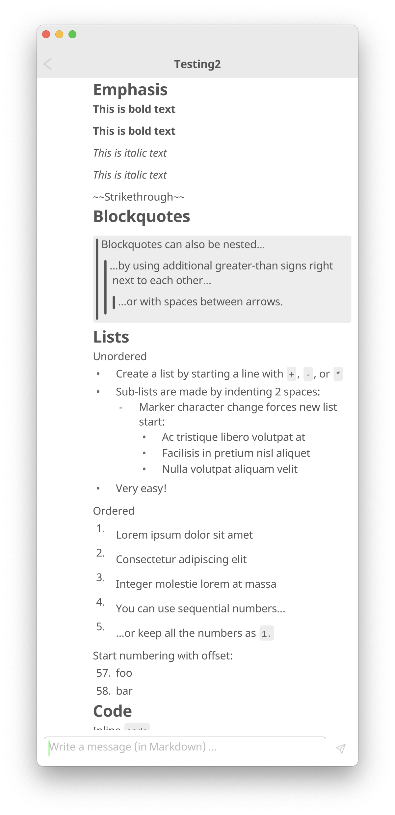
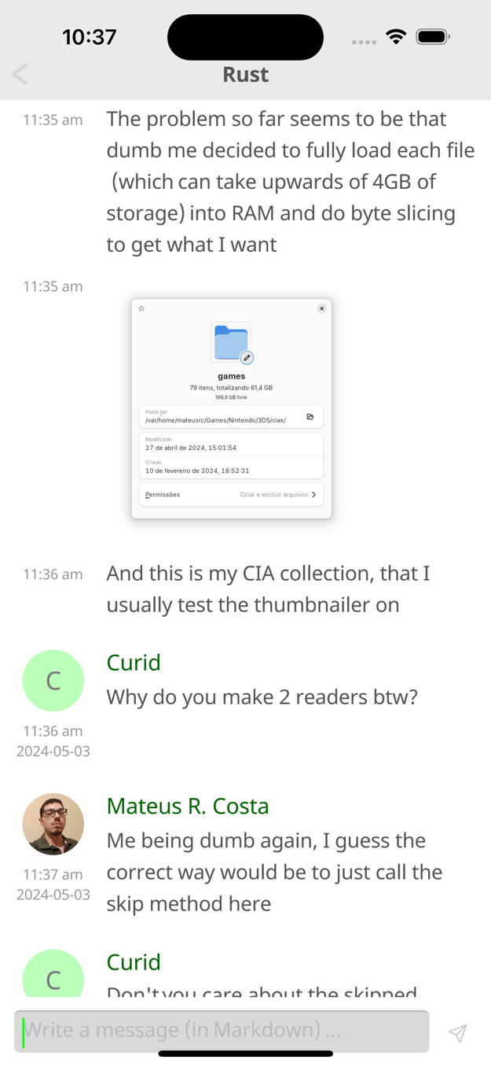
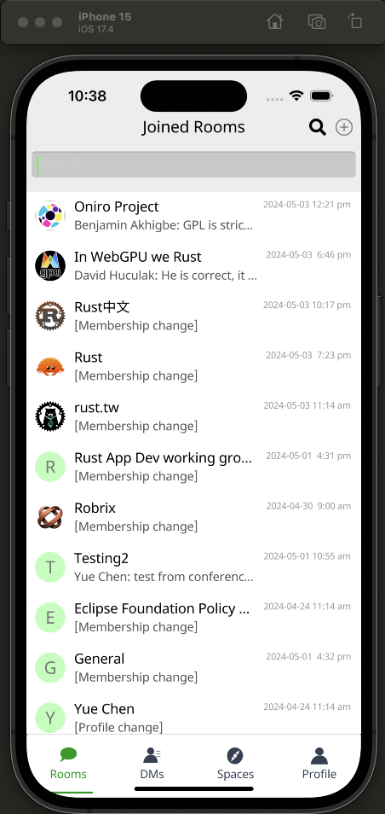
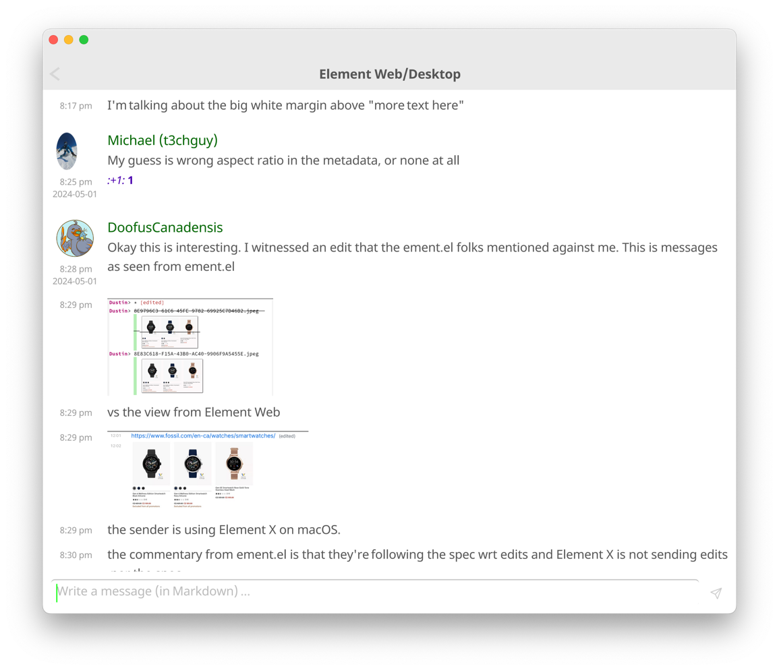
One code base, many platforms

Slide 3
Motivation
Why Robrix? Why Project Robius?

Slide 4



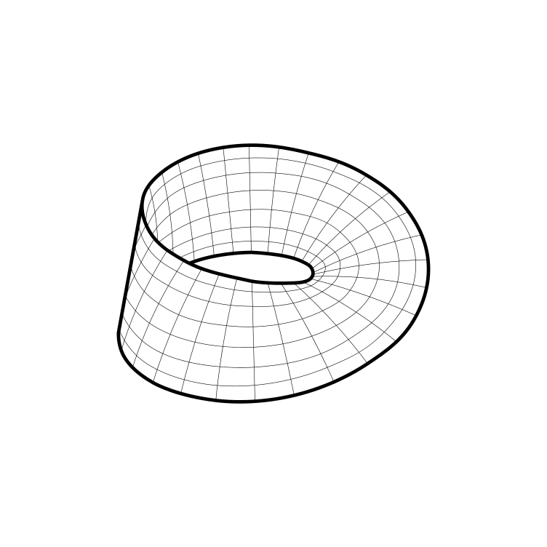
Project Robius at a glance
Create a multi-platform app dev experience fully in Rust
leverage the robust, safe, and performant Rust ecosystem
avoid dealing with multiple languages/environments
never write a single line of platform-specific code
Make Mobile a first-class concern in the Rust community
the Rust experience on Mobile has felt neglected
Devs can:
Notes:
Robius strives to do to two main things

Slide 5
Background — Project Robius app dev framework
Fully open-source, decentralized, and community-driven
Independent collaborators across US, Europe, Aus/NZ, S. America, China
All components written entirely in Rust
But why Robius? … there are already great Rust UI toolkits out there
egui, Iced, Slint, Leptos, Tauri, Dioxus, Makepad, Xilem, Freya, Ribir, …
→ There’s more to app dev than just drawing a GUI!
Traditionally, Rust apps have been “less Rust, more other code”
(a small Rust core surrounded by big platform-specific wrappers
Notes:
There are quite a few projects that experiment with how to build a great GUI using Rust; Dioxus, tauri, makepad, Xilem and the linebender project, etc. But to build a fully-featured app these days, you need an awful lot more than just UI and basic input events. That's what Project Robius is all about: we leave UI design to the experts, and step in to fill the gaps everywhere else in the app dev environment. This includes everything from complex build systems, support for platform-specific APIs and OS services (with nice Rust abstractions for each class of functionality), signing/packaging/bundling/distributing apps, and more. Everything is entirely open-source and decentralized. Nothing is owned or controlled by one party, and we welcome contributions from anyone and everyone.

Slide 6
Why Robrix, though?
Needed a key app to drive Robius development
“What kind of app is highly demanding?” (of UI & platform abstractions?)
A modern chat client!
Requires network, geolocation, file/image access, audio/video capture & playback, system notifications, clipboard, rich text formatting & input, persistent device storage & cache, connectivity mgmt, biometric auth, secret key storage, and so much more!
Why Matrix?
Shares our values: open-source, decentralized, community-driven, and now using Rust
Notes:
There are quite a few projects that experiment with how to build a great GUI using Rust; Dioxus, tauri, makepad, Xilem and the linebender project, etc. But to build a fully-featured app these days, you need an awful lot more than just UI and basic input events. That's what Project Robius is all about: we leave UI design to the experts, and step in to fill the gaps everywhere else in the app dev environment. This includes everything from complex build systems, support for platform-specific APIs and OS services (with nice Rust abstractions for each class of functionality), signing/packaging/bundling/distributing apps, and more. Everything is entirely open-source and decentralized. Nothing is owned or controlled by one party, and we welcome contributions from anyone and everyone.

Slide 7
Why Robrix, though?
Needed a key app to drive Robius development
A modern chat client is quite demanding
Matrix aligns with our values & goals
But then... since we’ve already started, why stop there? Let’s go further!
Can we make a super Matrix client for power users?
Can we make Robrix into a central “hub” for federated services?
Focus on the needs of open-source community & developers
Combine Matrix, ActivityPub, local AI LLMs, source code tools, etc.
The better the app, the stronger the case for Rust app dev!
Notes:
There are quite a few projects that experiment with how to build a great GUI using Rust; Dioxus, tauri, makepad, Xilem and the linebender project, etc. But to build a fully-featured app these days, you need an awful lot more than just UI and basic input events. That's what Project Robius is all about: we leave UI design to the experts, and step in to fill the gaps everywhere else in the app dev environment. This includes everything from complex build systems, support for platform-specific APIs and OS services (with nice Rust abstractions for each class of functionality), signing/packaging/bundling/distributing apps, and more. Everything is entirely open-source and decentralized. Nothing is owned or controlled by one party, and we welcome contributions from anyone and everyone.

Slide 8
Goals & Roadmap
(select high-level goals)
Notes:
Now that you have a bit of background on our larger project scope, let’s go over some of its goals (just a select subset, we have more technical goals covered in other project documentation)
As well as some of the goals and roadmap milestones of the Robrix app project specifically.

Slide 9
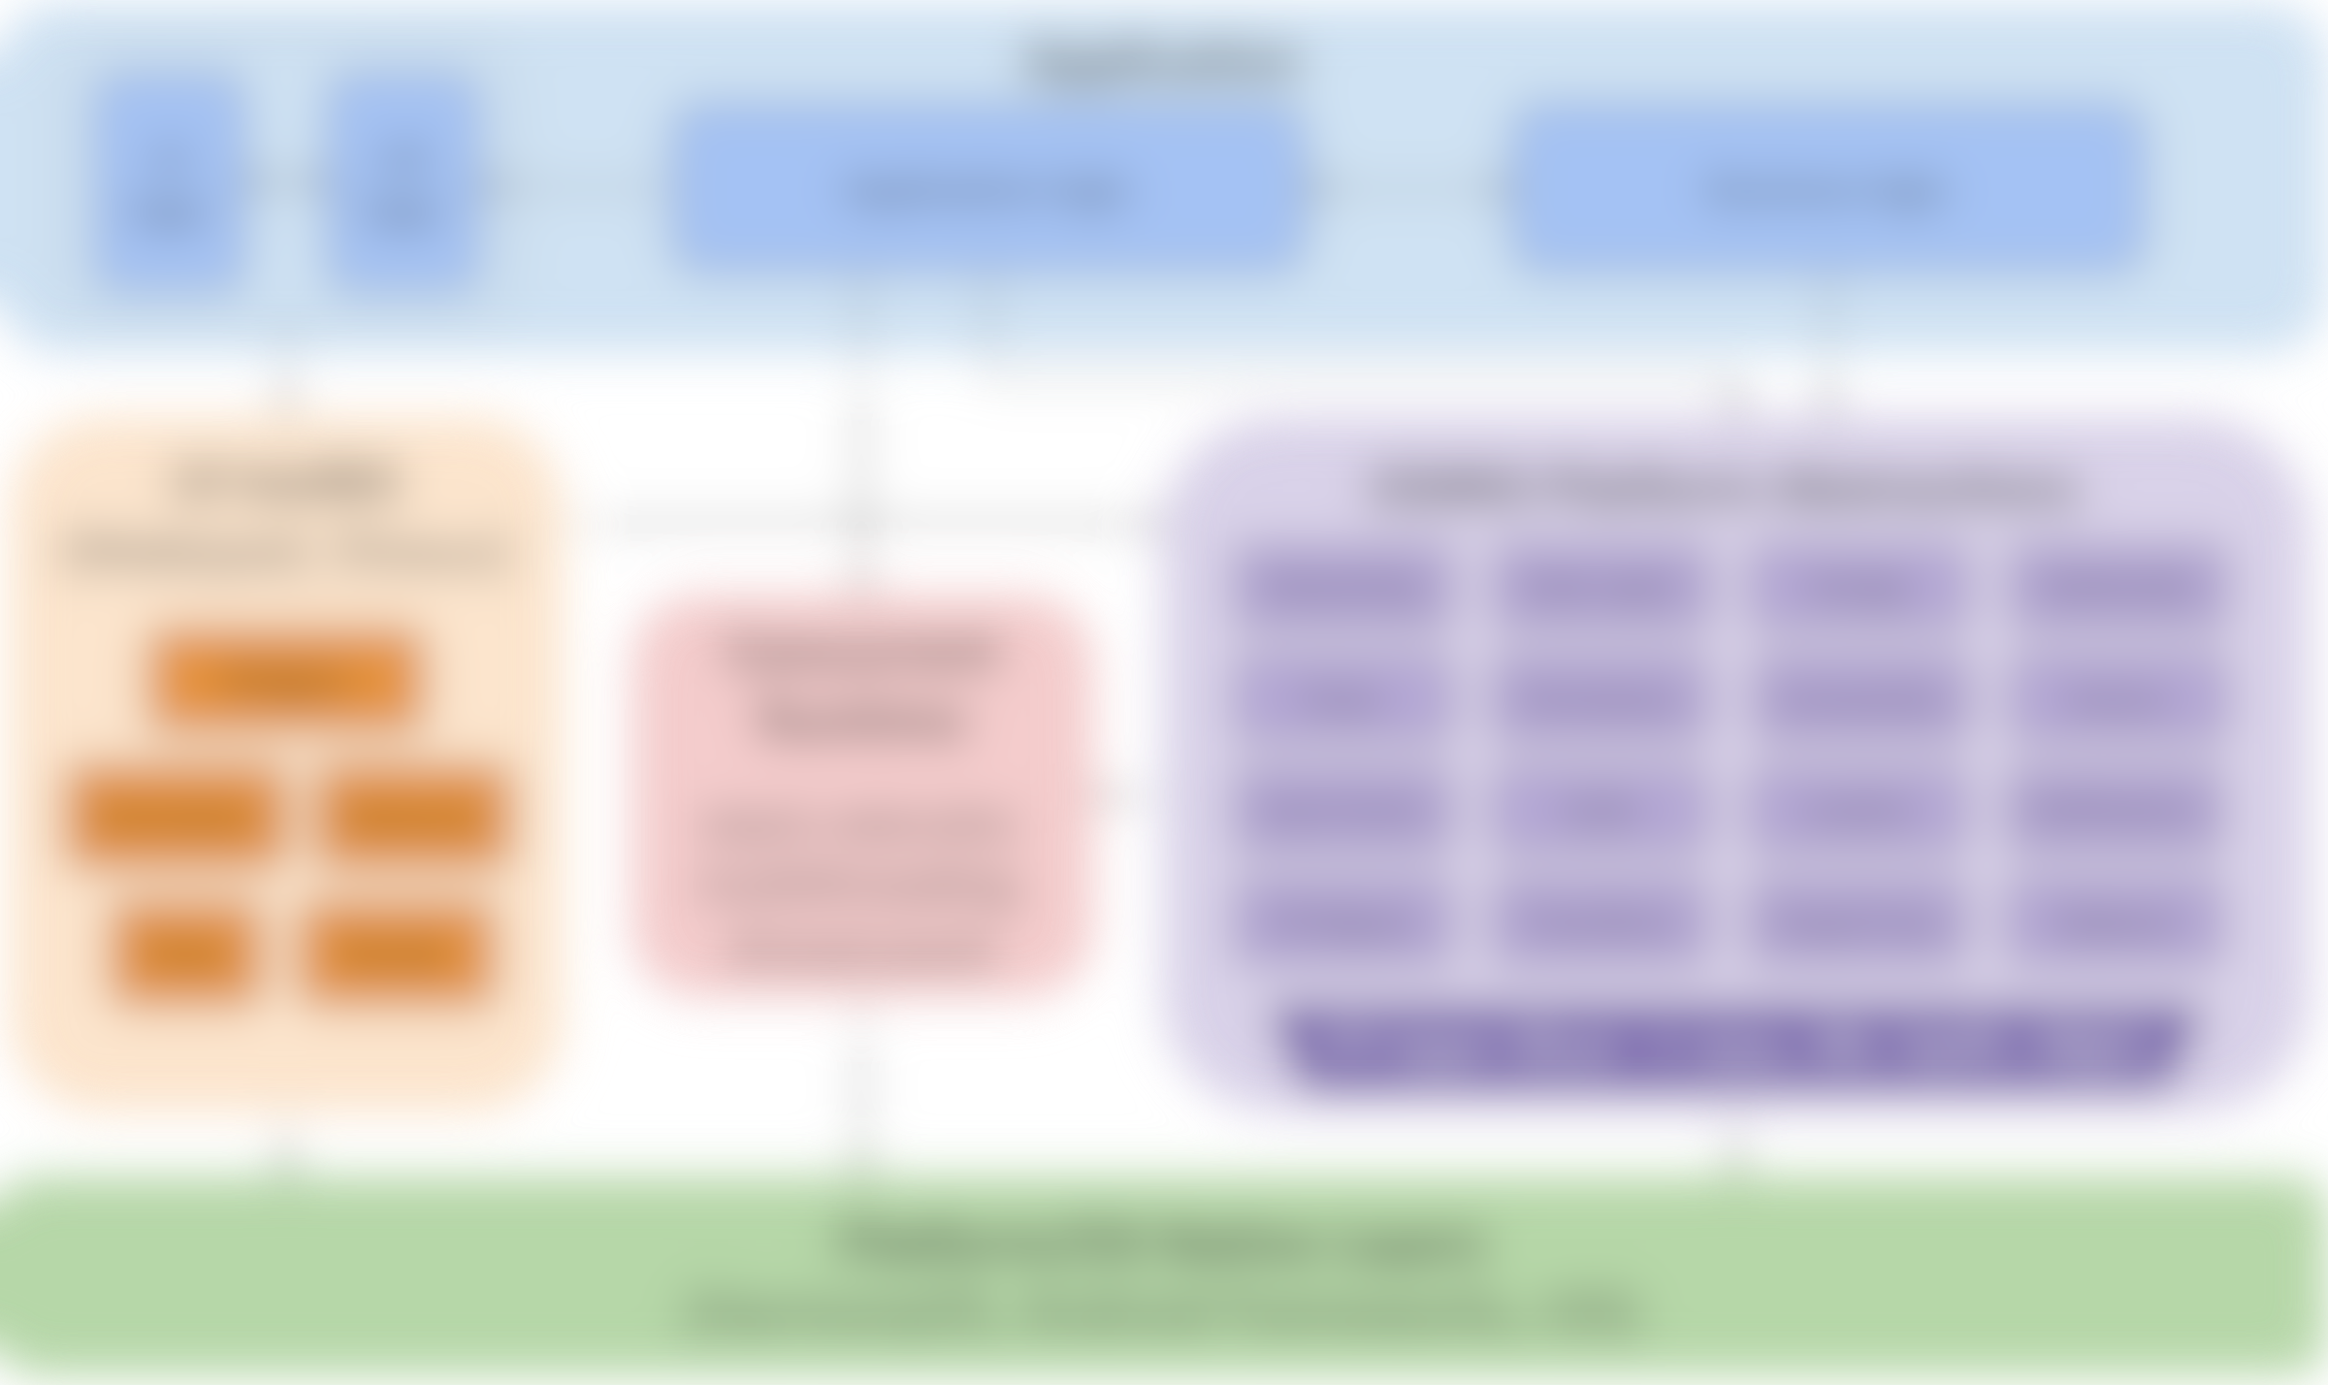
Primary goal: create reference design of full system stack
Application
UI logic
UX logic
Application logic
Business logic
runtime components
UI toolkit (Makepad, Dioxus)
Platform Abstractions
Concurrency “Manager”
Networking
Location
Storage
Multimedia
Widgets
Power
Permissions
Connectivity
Sensors
Animation
Gestures
main UI thread
async tasks
Other Events
Keychain
State mgmt
Notifications
Events
Drawing
IPC/Signals
Time/Alarm
Drag & Drop
Clipboard
bkgd thread workloads
comm. primitives
FFI layer (Rust → native language)
Platform/OS Native Layers (Linux, macOS, Windows, Android, iOS, Web, HarmonyOS …)
details coming later…
Notes:
Our primary goal is to establish a complete, working example of everything beneath the app
Which must support major platforms/OS environments
UI toolkits – Makepad, Dioxus, Slint
Offers a variety of UI development options and styles
Generally cross-platform, with a focus on GUI design and workloads
Rust abstractions of platform and OS-specific functionality
Focus on non-GUI subsystems
Standard subsystems: networking, storage, audio, time
UI-adjacent services: notifications, clipboard, drag & drop
Mobile-oriented:
Sensors/actuator: accelerometer/gyro, ambient light, pressure, temp, vibration, location, buttons, LEDs, biometrics
Multimedia: camera, mic, speaker
Touch screen, display brightness
Connectivity: WiFi discovery, bluetooth, NFC, USB, phone modem
Power: battery, charging, idle/standby/awake status
Permissions management: declaring, requesting, revoking
Goal: easy to integrate into a UI app as a dependency
Low-/zero-cost abstractions, as close to native as possible
Future: high-level, off-system mobile services
RESTful APIs: mapping, authentication, Google Play services, etc
Can likely use or start from the foundation of Open Mobile Hub
App dev-focused Concurrency management framework/library
Speaking from personal experience, it can be quite cumbersome and difficult to integrate and balance together many different execution contexts
Async tasks, which many SDKs force upon the user
Native OS Threads
The almighty main UI thread, which often has significant platform-enforced responsibilities and powers – difficult to handle and properly remember what workloads can only be run on the main UI thread
Balancing
Communicating between all of these different contexts without
thread pools, and CPU/multicore abstractions

Slide 10
Application
Application
UI / UX
Robrix App Architecture
(Matrix parts)
Robrix’s needs guide Robius development and implementation priority
Writing an actual app forces us to dogfood Robius (and Rust UI toolkits)
Convos/ rooms list
Chat view
Room browser
Application logic
Business logic (SDK use & more)
Persistent settings
Push notifs.
Local msg database
Online status
File sync
Join/ leave room
Matrix message send/recv
Read receipt
Settings, Themes
In-app notifs.
Context for chat/msg
Contacts
Image viewer
Video display
Create or delete chat
Quick replies
Access camera, mic, speaker
Multi-device login mgmt
Account management
File/media chooser
Search
Rich text fmt
Multimedia streaming, calling
Reactions
Local media storage
Authentication
Thread view
UI toolkit (Makepad, Dioxus)
Concurrency “Manager”
Platform Abstractions
Concurrent Runtime
async executor, multithreading, thread pools
Networking
Location
Storage/Cache
Multimedia
Widgets
main UI thread
async tasks
Input Events
Keychain
Connectivity
Notifications
Animation
Gestures
bkgd thread workloads
Authentication
Permissions
Drag & Drop
Clipboard
Events
Drawing
comm. primitives
FFI layer (Rust → native language)
Platform/OS Native Layers
Notes:
If we map this design of a full system stack to a specific app, it would look like this for Robrix.
Note that you obviously don’t need to understand every detail here.
In this case, we are also including the entire application component in the diagram, as we’re also responsible for developing.

Slide 11
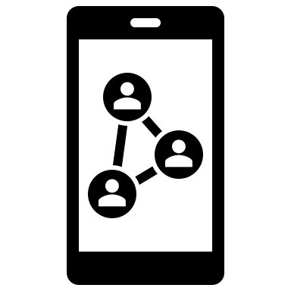




Meta-goals for Robrix as a flagship Robius app
Well-structured, well-commented code
Easy to fork and modify
Serves as a ready-made complex app template
Easy to contribute features back to upstream
Publish detailed walkthrough that guides a dev through how to make a (simplified) Robius app
Exemplify the utility & power of Robius framework
Demonstrate how nice & flexible Makepad apps can be

Slide 12



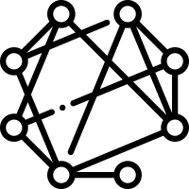
Roadmap
Stage 1: publish app with fundamental Matrix client features
Standard messaging, login, app persistence, E2EE support
Continue building full App Dev ecosystem and UI toolkit
Stage 2: Matrix client for “power” users
Feature parity with existing major clients (incl. administrative features)
Responsive UI design with side-by-side multi-room view
Local LLM runtime for AI chat bots & conversation summaries
Key point: does not jeopardize E2EE or data sovereignty
Stage 3: central “hub” for federated & open-source services
Collect multiple services: chat, discussion forums, code + issues + PRs, announcements/microblogs, feed of notifications/activity/news
Identity management via integration with OpenWallet
Notes:
Stage 1: [now] Robrix as a simple Matrix client
Try to reach fundamental featureset to prove Robius works
(whilst building the entire UI & App Dev ecosystem)
Structure of Robrix
Arch diagram of Robius, then Arch diagram of Robrix
Then actual block diagram of software components in Robrix
e.g., UI main thread, using Makepad components, using background threads, tokio for async, matrix rust SDK, the app talking to robius components off to the side, which talk directly to the platform
Demo of Robrix
Stage 2: [within 1 year] Robrix as a power-user Matrix client
Approx feature parity with existing clients
Plus more: side-by-side-by-side layout of horizontal panes (desktop, tablet, foldable)
Visually beautiful and customizable
Fast nav, keyboard-driven interaction mode
Integration of local LLMs for many benefits without jeopardizing E2EE or data sovereignty:
AI-assisted chat synopses, topic analysis, “what you missed”, etc
Automatic public chat-bot response channels to help newcomers to large open-source communities
Stage 3: [1+ year out] Robrix as a central hub for federated services
Introduce our vision for other services: ActivityPub, mastodon, lemmy, code/reviews (github)
All the stuff the open-source community wants, all in one place
Singular idenity management & support via integration with Open Wallet Foundation

Slide 13
Roadmap: Stage 1
Fundamental Matrix chat features

Slide 14
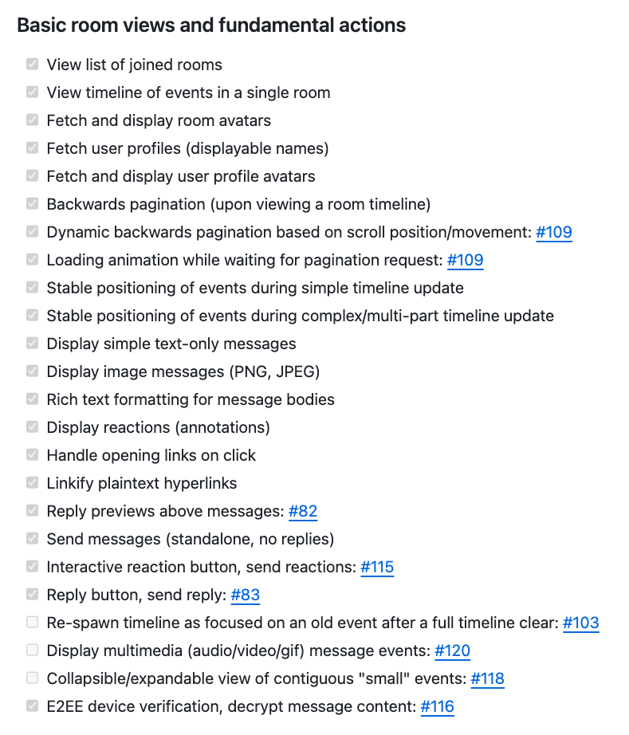
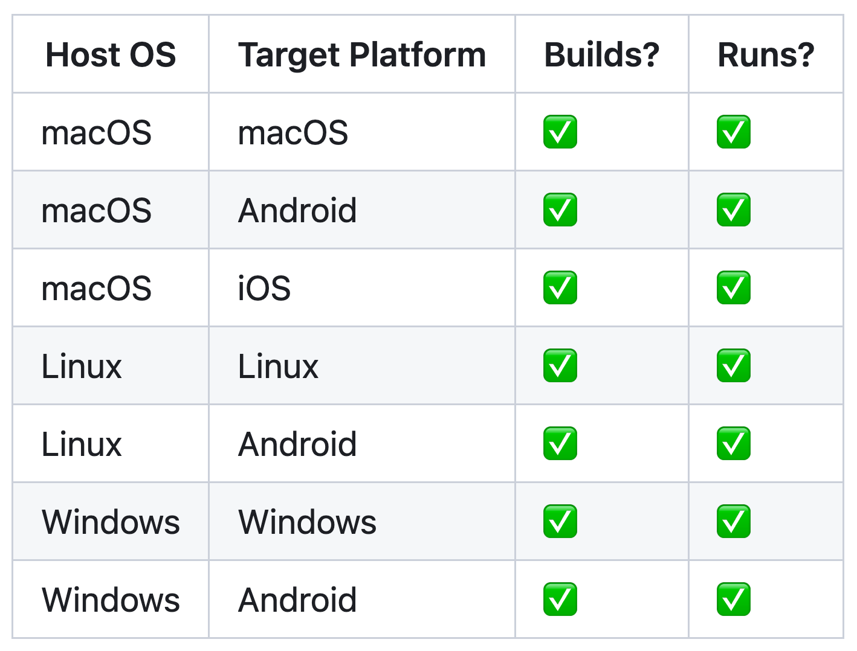
Stage 1: the basics
✅
Realize Matrix client fundamentals
Login, rooms list (sliding sync), basic messaging, annotations, replies, rich text formatting, images, E2EE support, app persistence
Publish alpha version of Robrix
Requires enhanced build tooling for releasing, signing, packaging
Complete platform support
Notes:
Finish Robrix app Stage 1: realizing fundamental Matrix client features.
Fundamental features include those required for basic use: login flow, persistent state, secret storage, E2EE support, inline replies, room search, message content search.
Excludes administrative features; those are part of Stage 2 below.
Publish Robrix to crates.io, Google Play store, and macOS app store.
Begin work to publish Robrix on iOS and Linux package managers.

Slide 15
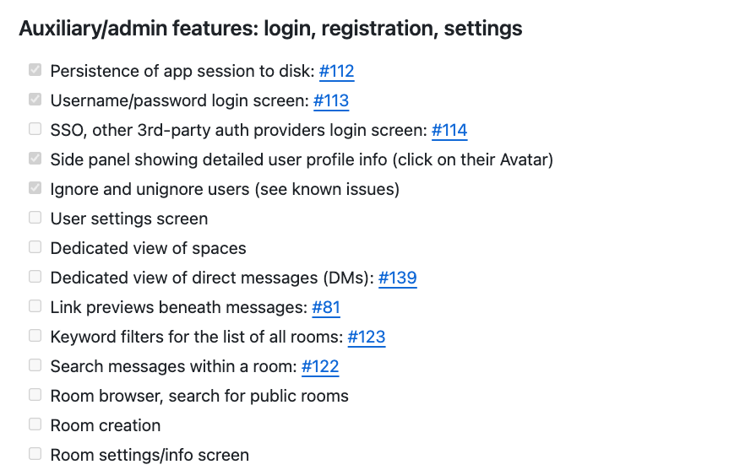
Some basics to save for Stage 2 (early 2025 beta)
Features that don’t drive Project Robius development

Slide 16
Significant implementation challenges
Exposing & abstracting platform APIs / OS services
Handling complex multi-step builds
Rust compilation: invoking & configuring Cargo
Standardizing compilation of non-Rust system glue layers
Supporting platform-specific toolchains and linking conventions
Defining and executing pre- and post-compilation steps
Signing, bundling, packaging, distributing apps
Required for system notifications, location (and so much more)
Managing concurrency: multi-threading, async vs. sync, hetero CPUs…
UI & other select workloads must run on “main” thread
Certain APIs require async, others forbid async
Contending with multiple vastly different UI toolkits
Platform feature crates must be easy to integrate with UI system internals
all across
disparate
platforms
Notes:
Permissions handling
Collecting and merging permissions from app, UI toolkit, dependencies

Slide 17
Targeted platform abstractions / OS service APIs
System notifications
Biometrics & authentication
File/image picker dialogs
Context menus (OS-native)
Menu bar (desktop only)
Rich clipboard
Drag & Drop
Default URI/Intent handling
Content sharing to foreign app
Native font access
Input Method Editors (IME)
Native gesture recognition
Connectivity management
WiFi, Bluetooth, NFC, nearby devices
GPS/Location access
Multimedia capture
Device discovery & configuration
Camera – snapshots, video, settings
Audio – input, MIDI, playback
Sensors
Native alarms, timers
Keychain (secret storage)
Power management/status
App lifecycle state transitions
OS-standard data directories
and so much more …

Slide 18
Prior status update (spring 2024)
System notifications
Biometrics & authentication
File/image picker dialogs
Context menus (OS-native)
Menu bar (desktop only)
Rich clipboard
Drag & Drop
Default URI/Intent handling
Content sharing to foreign app
Native font access
Input Method Editors (IME)
Native gesture recognition
Connectivity management
WiFi, Bluetooth, NFC, nearby devices
GPS/Location access
Multimedia capture
Device discovery & configuration
Camera – snapshots, video, settings
Audio – input, MIDI, playback
Sensors
Native alarms, timers
Keychain (secret storage)
Power management/status
App lifecycle state transitions
OS-standard data directories
and so much more …
Notes:
Most of these, but not all, are useful within Robrix but not technically mandatory.
Approximate proposed order:
Biometrics/authentication
Open URI / share object to another app (Intents, “sharesheet”)
Geolocation
System notifications
Native file/image picker dialog
Native font access (fallback for UI-packaged font stack)
Registration as default app (Intent handler)
Native rich clipboard access with full-MIME types
Native context menus

Slide 19
Current status (autumn 2024)
System notifications
Biometrics & authentication
File/image picker dialogs
Context menus (OS-native)
Menu bar (desktop only)
Rich clipboard
Drag & Drop
Default URI/Intent handling
Content sharing to foreign app
Native font access
Input Method Editors (IME)
Native gesture recognition
Connectivity management
WiFi, Bluetooth, NFC, nearby devices
GPS/Location access
Multimedia capture
Device discovery & configuration
Camera – snapshots, video, settings
Audio – input, MIDI, playback
Sensors
Native alarms, timers
Keychain (secret storage)
Power management/status
App lifecycle state transitions
OS-standard data directories
and so much more …
Notes:
Most of these, but not all, are useful within Robrix but not technically mandatory.
Approximate proposed order:
Biometrics/authentication
Open URI / share object to another app (Intents, “sharesheet”)
Geolocation
System notifications
Native file/image picker dialog
Native font access (fallback for UI-packaged font stack)
Registration as default app (Intent handler)
Native rich clipboard access with full-MIME types
Native context menus

Slide 20
Project Robius contributions used in real apps
robius-location
robius-keychain (will upstream to keyring-rs)
robius-android-env
android-build
robius-directories (fork of directories plus Android)
robius-open
robius-authentication
robius-url-handler
cargo-packager
Makepad

Slide 21
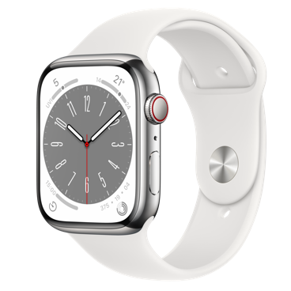








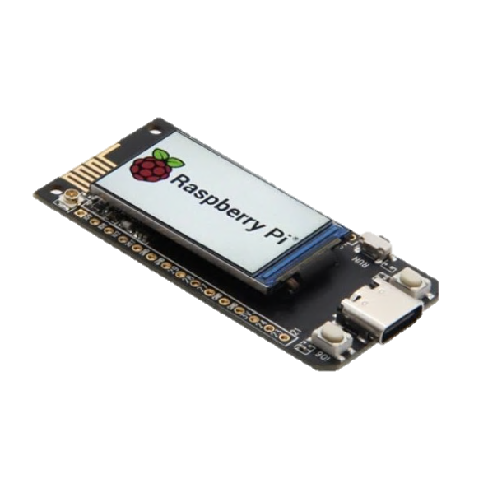
Platforms of interest
Desktop
macOS
Linux (Debian-based, Arch)
Windows
Mobile
Android
iOS
[soon] OpenHarmony OS
Web, wasm
Others?
Select microcontrollers/peripherals
tvOS, watchOS

Slide 22
Demo time!
Makepad UI features
Robius platform abstractions

Slide 23
<demo> for future/offline viewers: the demo included an overview of Robrix running on macOS and Android. Check out our git repo and run it on your own machine here: https://github.com/project-robius/robrix
23
Notes:
go over structure of components we’ve designed
Custom HTML parser & renderer
Extremely lightweight, no web engine, no CSS
Custom caching layer for drawing & populating UI widgets
Able to integrate with fine-grained events from Matrix SDK

Slide 24
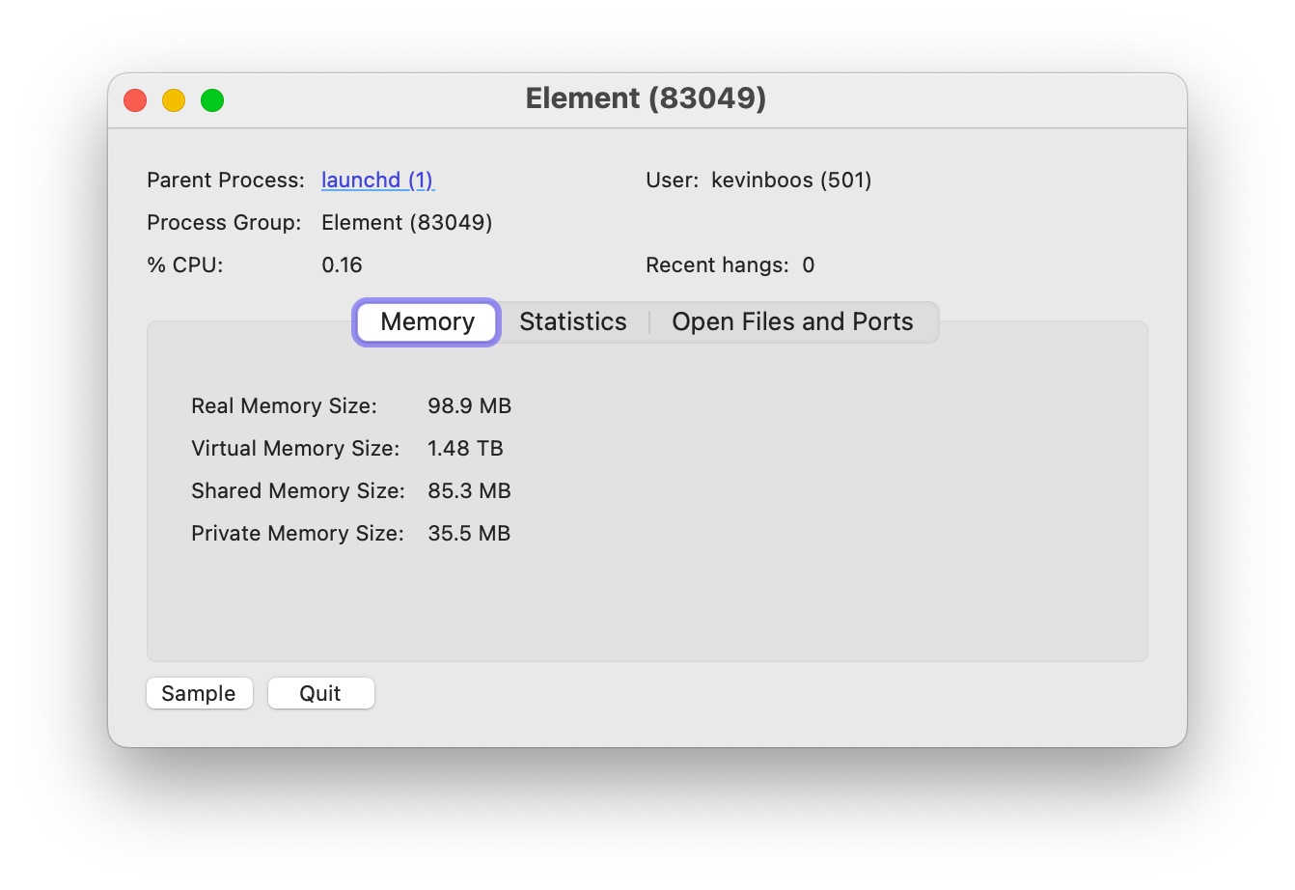



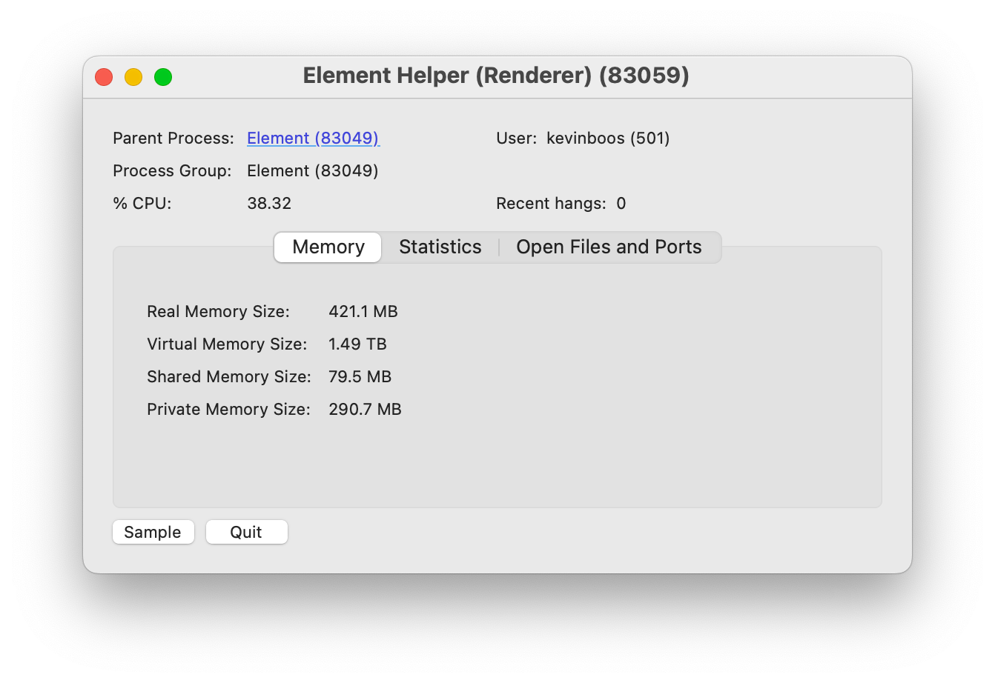
Makepad + Robius stack is efficient
30% fonts
32% framebuffers
→ Related benchmarks for Makepad:
robius.rs/blog/performance-benchmarking-2/
Notes:
Plus a sub-10 sec compile time from a clean build

Slide 25
Select Challenges
(in brief)

Slide 26
Robrix development revealed a concurrency challenge
impl Widget for TimelineView {
fn draw_walk(&mut self, cx: &mut Cx2d, scope: &mut Scope, walk: Walk) -> DrawStep {
while let Some(item_id) = self.list.next_visible_item(cx) {
let Some(timeline_item) = self.tl_items.get(tl_idx) else { ... }; if let TimelineItemKind::Event(event_tl_item) = match timeline_item.kind() {
if let TimelineItemContent::Message(message) = event_tl_item.content() {
if let MessageType::Image(image) = message.msgtype() {
let (item, existed) = list.item (cx, item_id, live_id!(ImageMessage))?;
let Some(mimetype, width, height) = image.info.as_ref() else { return }; let text_or_image_widget = item.text_or_image(id!(content.message));
let media_request = MediaRequest { source: image.source, format: ... };
let data = matrix_client.media().get_media_content(&media_request, true).await?;
text_or_image_widget.show_image(|img| utils::load_png_or_jpg(&img, cx, &data));
...
}
}
}
}
}
}
A typical first attempt to fetch and draw an image
error[E0728]: `await` is only allowed inside `async` functions and blocks
|
1048 | fn draw_walk(
| ------------- this is not `async`
...
1132 | let data = matrix_client.media().get_media_content(&media_request, true).await?;
only allowed inside `async` functions and blocks ^^^^^
Notes:
Insert slide of some simplified code that shows two problems when failing to properly deal with mixed (forms of) concurrency
Invoking a blocking function from the main UI thread will hang the UI
Even if the function is async, it could still be blocked while the async executor is running during its timeslice
Key point: don’t try to run async functions (spawn async tasks) on the main UI thread
Trying to invoke an async function directly from the main thread
Also happens if you did it from a regular background thread

Slide 27
Robrix development revealed a concurrency challenge
impl Widget for TimelineView {
fn draw_walk(&mut self, cx: &mut Cx2d, scope: &mut Scope, walk: Walk) -> DrawStep {
while let Some(item_id) = self.list.next_visible_item(cx) {
let Some(timeline_item) = self.tl_items.get(tl_idx) else { ... }; if let TimelineItemKind::Event(event_tl_item) = match timeline_item.kind() {
if let TimelineItemContent::Message(message) = event_tl_item.content() {
if let MessageType::Image(image) = message.msgtype() {
let (item, existed) = list.item (cx, item_id, live_id!(ImageMessage))?;
let Some(mimetype, width, height) = image.info.as_ref() else { return }; let text_or_image_widget = item.text_or_image(id!(content.message));
let media_request = MediaRequest { source: image.source, format: ... };
let data = tokio::spawn(async {
matrix_client.media().get_media_content(&media_request, true).await?
});
text_or_image_widget.show_image(|img| utils::load_png_or_jpg(&img, cx, &data));
...
} } } } } }
Ok, let’s try the request in a spawned async task
thread 'main' panicked at src/home/room_screen.rs:1128:25:
there is no reactor running, must be called from the context of a Tokio 1.x runtime
Notes:
Insert slide of some simplified code that shows two problems when failing to properly deal with mixed (forms of) concurrency
Invoking a blocking function from the main UI thread will hang the UI
Even if the function is async, it could still be blocked while the async executor is running during its timeslice
Key point: don’t try to run async functions (spawn async tasks) on the main UI thread
Trying to invoke an async function directly from the main thread
Also happens if you did it from a regular background thread

Slide 28
Robrix development revealed a concurrency challenge
Obvious: must not block the main UI thread
Invoking a blocking (sync) function from the main thread will hang the UI
Especially if it causes a syscall, where the OS may put the thread to sleep
Less obvious: async functions can also block the main thread
Even if the function is async, that native thread could still be blocked while the async executor is polling the future being awaited
Same issue can occur on background threads, too (but that’s ok)
Key point:
→ Don’t invoke any blocking functions, even “non-blocking” async (on the main UI thread)
→ Results in a very performant UI, as you saw in the demo

Slide 29
Robrix development revealed a concurrency challenge
impl Widget for TimelineView {
fn draw_walk(&mut self, cx: &mut Cx2d, scope: &mut Scope, walk: Walk) -> DrawStep {
while let Some(item_id) = self.list.next_visible_item(cx) {
let Some(timeline_item) = self.tl_items.get(tl_idx) else { ... }; if let TimelineItemKind::Event(event_tl_item) = match timeline_item.kind() {
if let TimelineItemContent::Message(message) = event_tl_item.content() {
if let MessageType::Image(image) = message.msgtype() {
let (item, existed) = list.item (cx, item_id, live_id!(ImageMessage)).unwrap();
let Some(mimetype, width, height) = image.info.as_ref() else { return }; let text_or_image_widget = item.text_or_image(id!(content.message));
if let MediaSource::Plain(mxc_uri) => &image.source {
match self.media_cache.try_get_media_or_fetch(mxc_uri.clone(), None) {
MediaCacheEntry::Loaded(data) => {
text_or_image_widget.show_image(|img| utils::load_png_or_jpg(&img, cx, &data));
...
MediaCacheEntry::Requested => {
text_or_image_widget.set_text(&format!("Fetching image from {:?}", mxc_uri));
}
MediaCacheEntry::Failed => {
text_or_image_widget.set_text(&format!("Failed to fetch image from {:?}", mxc_uri));
}
} ...
Solution:
A concurrency-aware impl that requests an async function to be run in a different context
Notes:
Insert slide of some simplified code that shows two problems when failing to properly deal with mixed (forms of) concurrency
Invoking a blocking function from the main UI thread will hang the UI
Even if the function is async, it could still be blocked while the async executor is running during its timeslice
Key point: don’t try to run async functions (spawn async tasks) on the main UI thread
Trying to invoke an async function directly from the main thread
Also happens if you did it from a regular background thread

Slide 30
Robrix development revealed a concurrency challenge
/// Tries to get the media from the cache, or submits an async request to fetch it.
///
/// This method *does not* block or wait for the media to be fetched,
/// and will return `MediaCache::Requested` while the async request is in flight.
/// If a request is already in flight, this will not issue a new redundant request.
pub fn try_get_media_or_fetch(&mut self, mxc_uri: OwnedMxcUri ...) -> MediaCacheEntry {
let value_ref = match self.entry(mxc_uri.clone()) {
Entry::Vacant(vacant) => vacant.insert(MediaCacheEntry::Requested),
Entry::Occupied(occupied) => return occupied.get()...,
};
async_ctx::submit_async_request(
MatrixRequest::FetchMedia {
media_request: mxc_uri.into(),
},
);
...
}
/// Submits a request to the worker thread
/// to be executed in an async context.
pub fn submit_async_request(req: MatrixRequest) {
REQUEST_SENDER.get().send(req);
}
Notes:
Insert slide of some simplified code that shows two problems when failing to properly deal with mixed (forms of) concurrency
Invoking a blocking function from the main UI thread will hang the UI
Even if the function is async, it could still be blocked while the async executor is running during its timeslice
Key point: don’t try to run async functions (spawn async tasks) on the main UI thread
Trying to invoke an async function directly from the main thread
Also happens if you did it from a regular background thread

Slide 31
Robrix development revealed a concurrency challenge
/// Submits a request to the worker thread
/// to be executed in an async context.
pub fn submit_async_request(req: MatrixRequest) {
REQUEST_SENDER.get().send(req);
}
pub enum MatrixRequest {
FetchMedia {
media_request: MediaRequest,
on_fetched: fn(&Mutex<MediaCacheEntry>, MediaRequest, ...),
destination: Arc<Mutex<MediaCacheEntry>>,
update_sender: crossbeam_channel::Sender<TimelineUpdate>,
...,
} }
triggers async request handler
async fn async_worker(mut receiver: UnboundedReceiver<MatrixRequest>) -> Result<()> {
while let Some(request) = receiver.recv().await {
match request { MatrixRequest::FetchMedia { media_request, on_fetched, destination, update_sender } => {
Handle::current().spawn(async move {
let img_data = client.media().get_media_content(&media_request, true).await;
on_fetched(&destination, media_request, img_data, update_sender);
});
} } } }
This same pattern is used for back pagination, sending messages, etc
Notes:
Insert slide of some simplified code that shows two problems when failing to properly deal with mixed (forms of) concurrency
Invoking a blocking function from the main UI thread will hang the UI
Even if the function is async, it could still be blocked while the async executor is running during its timeslice
Key point: don’t try to run async functions (spawn async tasks) on the main UI thread
Trying to invoke an async function directly from the main thread
Also happens if you did it from a regular background thread

Slide 32
Generic solution for mixed concurrency contexts
direct function call
sync –> sync channel
sync –> async channel
async –> sync channel
non-blocking requests to async funcs
responses from async funcs;
visual updates from backend server
UI main thread
Background thread in async runtime pool
App main func, draw routines, event handlers
Background thread
non-blocking requests to bkgd (sync) functions
App logic calling async platform APIs
App logic calling sync platform APIs
Nested sync requests, which may also (rarely) require async functions
App logic using Matrix
non-blocking
media lookup (fast path)
Makepad UI toolkit
media cache (shared memory)
insert fetched media (sync)
insert fetched media (async)
Robius Platform Abstractions
Matrix SDK
Platform/OS Native Layers
Notes:
App main thread is managed by and talks to the Makepad UI toolkit
Obviously want to avoid blocking this thread at all costs
Sends off requests that require synchronous operations to background threads
Sends of requests that require async operations to background threads that are managed by an async executor that can run async tasks
Certain platform-specific functions must only be invoked on main thread
But, many service SDKs are built atop async/await
e.g., the Matrix SDK requires async for many of its features (exposes only async fn()s)
Should not run async workloads on UI main thread
We have other non-async work that we also want to in the background
In total, we must contend with 3 categories of workloads
Currently use multiple types of channels, queues, and condvars to facilitate inter-context communication
Aim to create a better design here that helps to abstract away the manual tedium of passing messages across many kinds of channels

Slide 33

More challenging example: device verification
direct function call
sync –> sync channel
sync –> async channel
async –> sync channel
UI main thread
Background thread(s)
Async task(s) pool
1
Register verification handler
2
Incoming verification request
3
Display verification prompt
User accepts or rejects
4
Send accept/reject to other device
5
Wait for other device response, forward to UI, start SAS verification
6
Display SAS prompt, emoji
User confirms /denies match
7
Send SAS confirm/deny to other
9
✅
Display final result
8
Wait for other to confirm/deny
Makepad UI toolkit
Matrix SDK
Other device
OS/Platform Native Layers & Robius Platform Abstractions
Notes:
The most challenging incarnation of this that we’ve encountered, which is the verification modal.
Multiple finite state machines operating in different execution contexts, which both must be kept in lockstep together and in sync with another Matrix client instance (the one doing the verification)
This is incredibly difficult to implement given the constraints of what you can and should do on the main UI thread (i.e., not acquiring locks, not awaiting on an async task, etc)
Also the constraints of where async tasks can run, and which SDK APIs and system APIs require invoking in an async or sync context, or may be a blocking vs. non-blocking call
Note that this diagram excludes a vast amount of complexity surrounding timeouts, handling cancelations from both the local user and the other foreign device, restarting or being tolerant of network errors,
GOAL: to make this a lot easier for future app devs
Will be part of our future concurrency management framework

Slide 34
<demo> for future/offline viewers: the demo included an example of device verification working between Robrix and the Element Desktop client. Check out our git repo and run it on your own machine here: https://github.com/project-robius/robrix
34
Notes:
go over structure of components we’ve designed
Custom HTML parser & renderer
Extremely lightweight, no web engine, no CSS
Custom caching layer for drawing & populating UI widgets
Able to integrate with fine-grained events from Matrix SDK

Slide 35
<code example> for future/offline viewers: the demo included a walkthrough of the device verification implementation showing its complexity and sharp edges. Check out our git repo and run it on your own machine here: https://github.com/project-robius/robrix
35
Notes:
go over structure of components we’ve designed
Custom HTML parser & renderer
Extremely lightweight, no web engine, no CSS
Custom caching layer for drawing & populating UI widgets
Able to integrate with fine-grained events from Matrix SDK

Slide 36


Stage 1: summary + looking forward
Robrix (and Robius) are only just getting started!
Many diverse challenges remain across UI, platform, build, tooling
Active collaboration with UI toolkits to drive daily improvements
2024 Roadmap
Continue developing key feature & platform abstraction crates
Publish first alpha version of Robrix
End-to-end guided walkthroughs: how to create a simple app
like Robrix atop Robius

Slide 37
Future Roadmap Stages
Stage 2: Matrix for power users
Stage 3: Fediverse community hub

Slide 38
Stage 2 — a Matrix client for power users
Feature parity with existing clients
Responsive UI with side-by-side panes & dockable tabs
Visually beautiful and customizable across desktop, tablet, foldable, mobile
Fast navigation with keyboard-driven interaction mode
Integration with local LLMs to leverage AI benefits
Automated topic analysis, chat synopses of “what you missed”, etc.
Chatbot response channels to help newcomers in large open-source communities
Local LLM runtime preserves E2EE & data sovereignty
Notes:
Explore Integration of local LLMs (à la Moxin) for many benefits without jeopardizing E2EE or data sovereignty:
AI-assisted chat synopses, topic analysis, “what you missed”, etc.
Automatic public chat-bot response channels to help newcomers to large open-source communities.
Some sort of AI features: auto-response bots for simple/frequent/easy questions, some sort of AI assistant to help you pick out key important messages from a long backlog

Slide 39
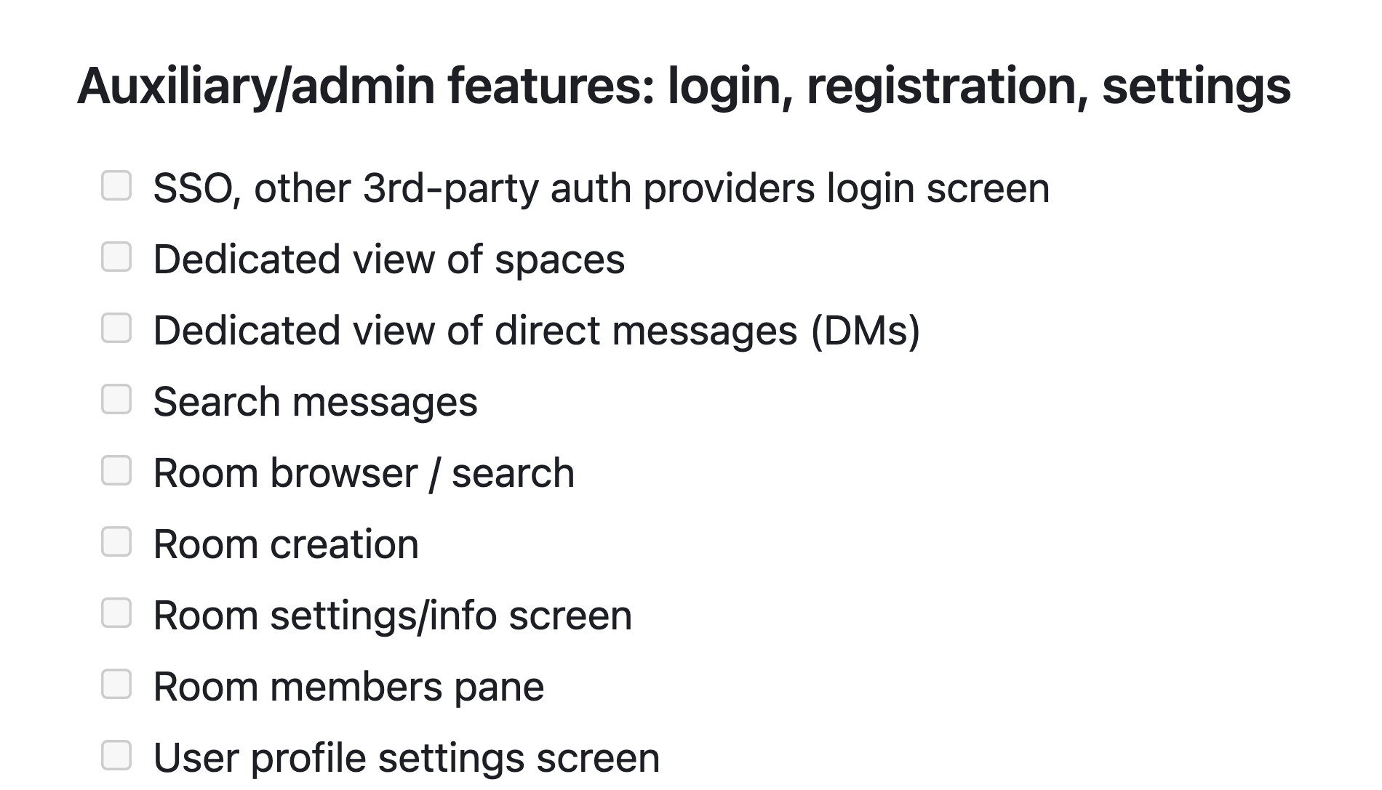
A. Reach feature parity with existing clients
Finish up features that weren’t needed to drive Project Robius features

Slide 40
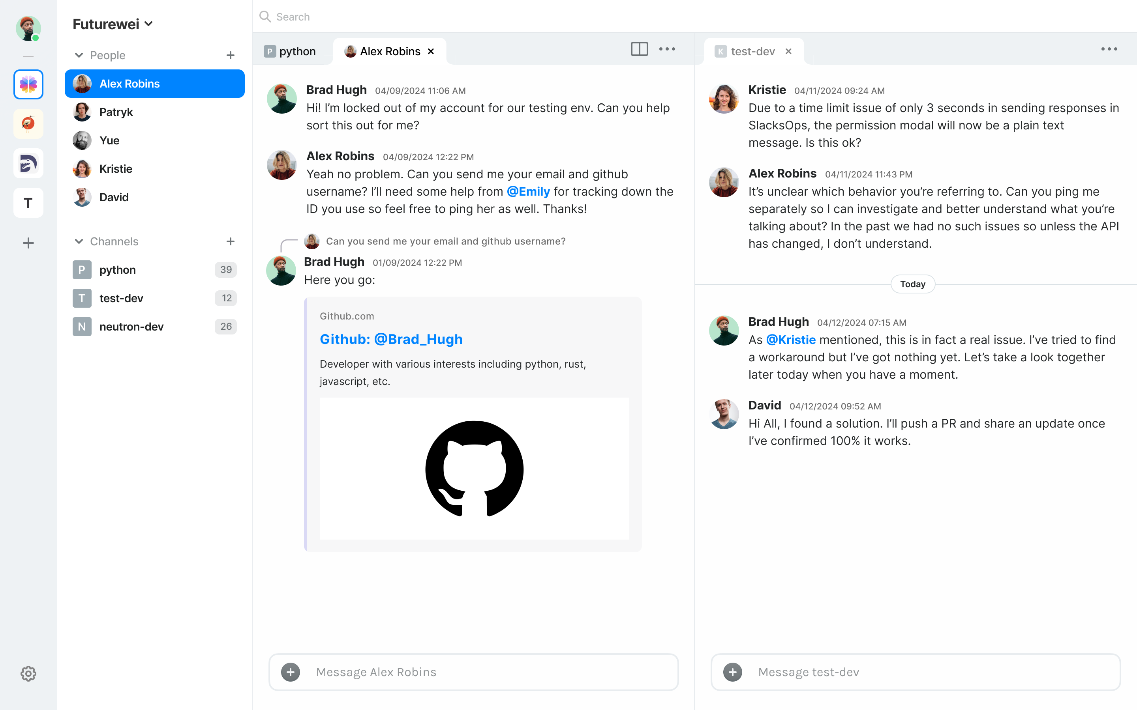
B. Multi-pane dockable tab UI
(the original design proposal)

Slide 41
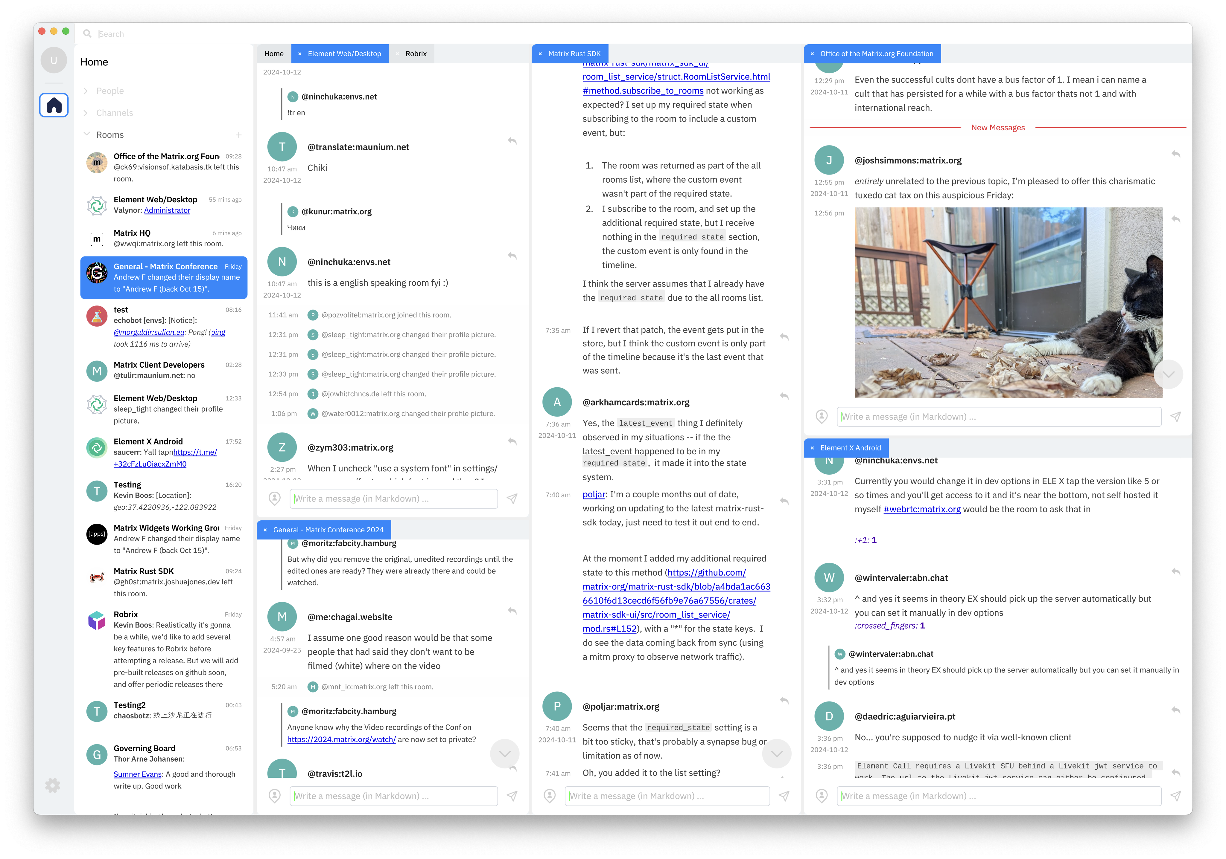
Robrix’s actual (brand new) "IDE" UI
Auto-adapts to screen sizes
Same code works on Desktop, Mobile, Tablet...
Unlock productivity for work/social chats (just like an IDE)

Slide 42

C. AI features — local LLM integration via Moxin
Discord’s new chat topic summaries
Wouldn’t it be great to have these for Matrix chats?
But how can this work without giving an AI service access to all of your data?
Local LLMs — benefit from AI without jeopardizing E2EE, data sovereignty
“What’s happening”: AI-driven conversation summaries & topic analysis
“Action items”: AI identifies important messages & to-dos from a long backlog
Automated chatbots for handling public FAQs in an open-source project community
Longer-term: share LLM agents’ recipes and bot demos via Matrix
Currently not offered by existing tools like ChatGPT
Notes:
Future integration with Moxin, another Project Robius app being developed: “The Moxin App also integrates with the social community. It now supports an open-source model database/model card. The community can help improve the model card and add and validate more models. Also, we plan to fully integrate with the federated Matrix ecosystem so people can share the agents' recipes and demo their little bots, which ChatGPT or other tools do not provide as of today."

Slide 43
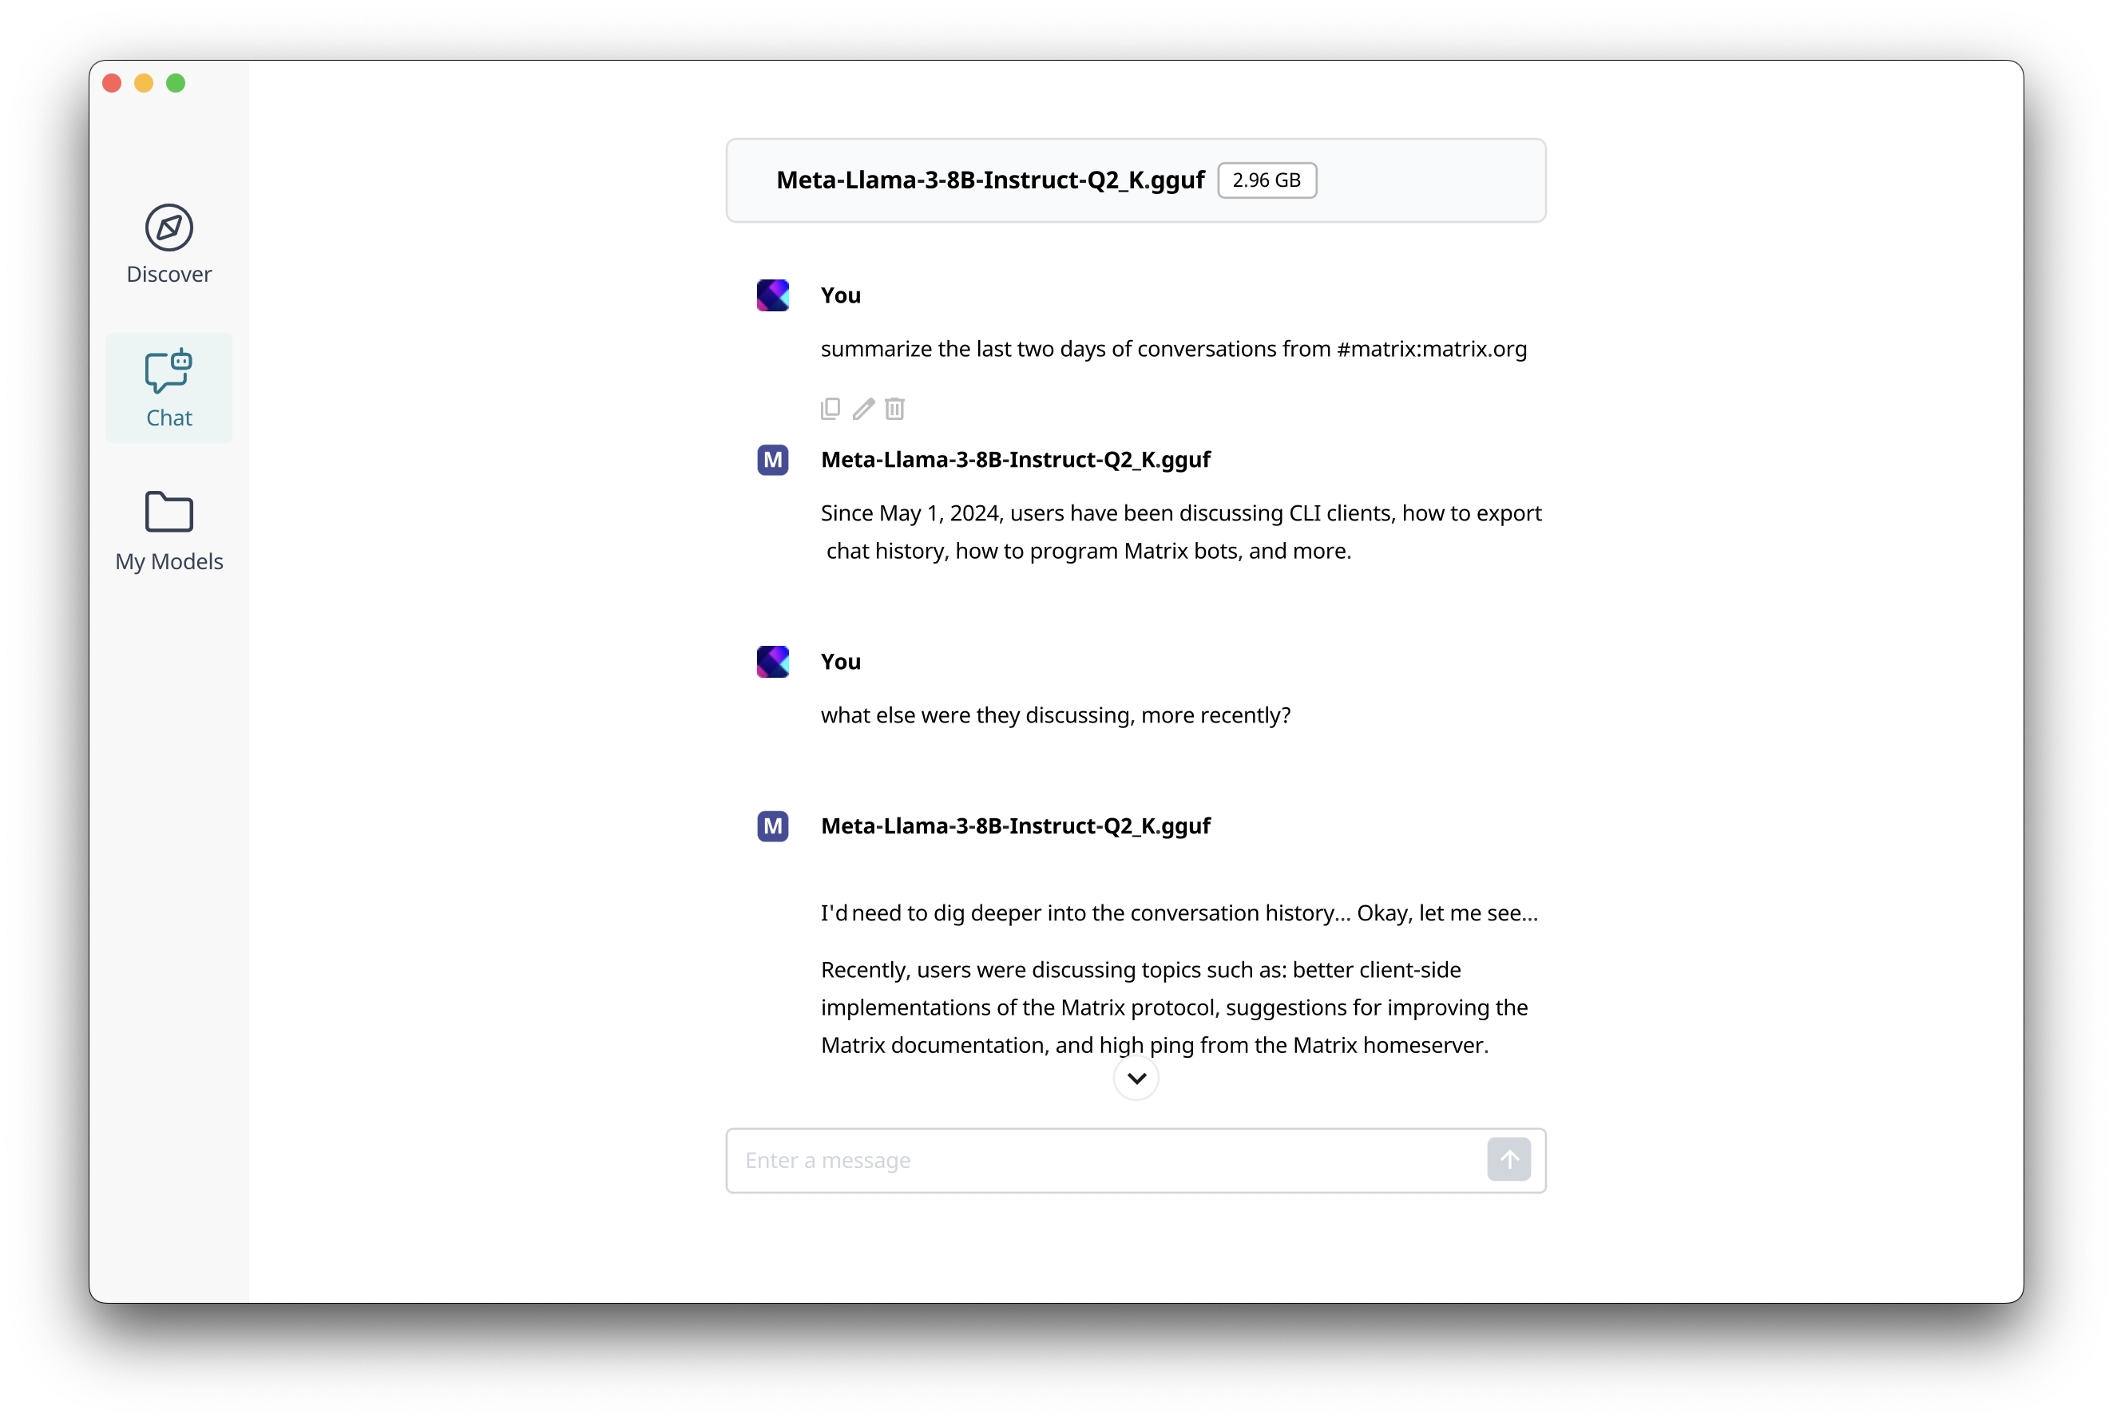
Robrix in-app AI chat
AI Chat

Slide 44
AI Chat
AI model is user’s choice

Slide 45
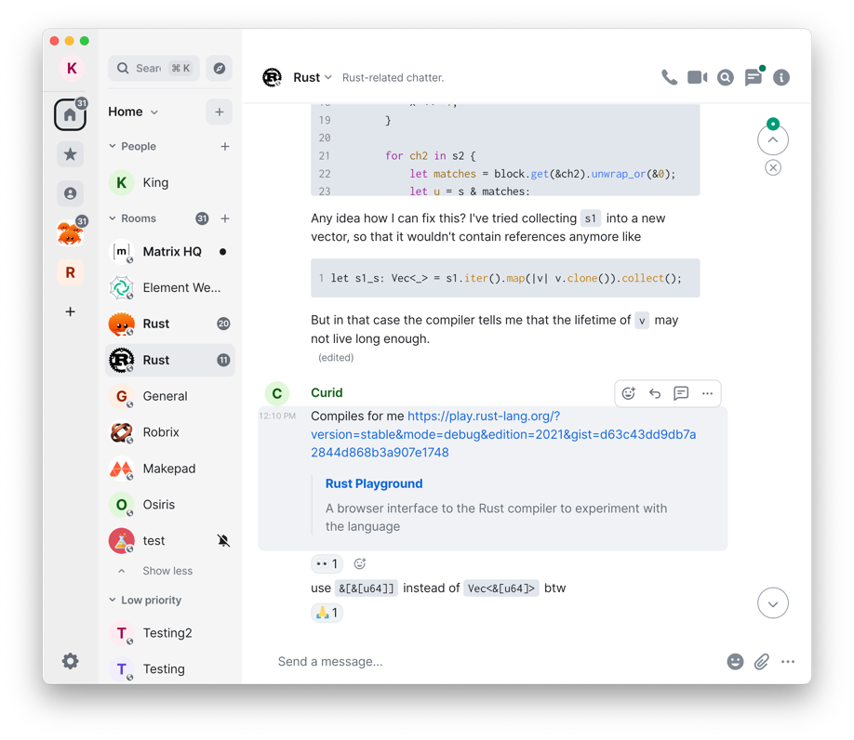
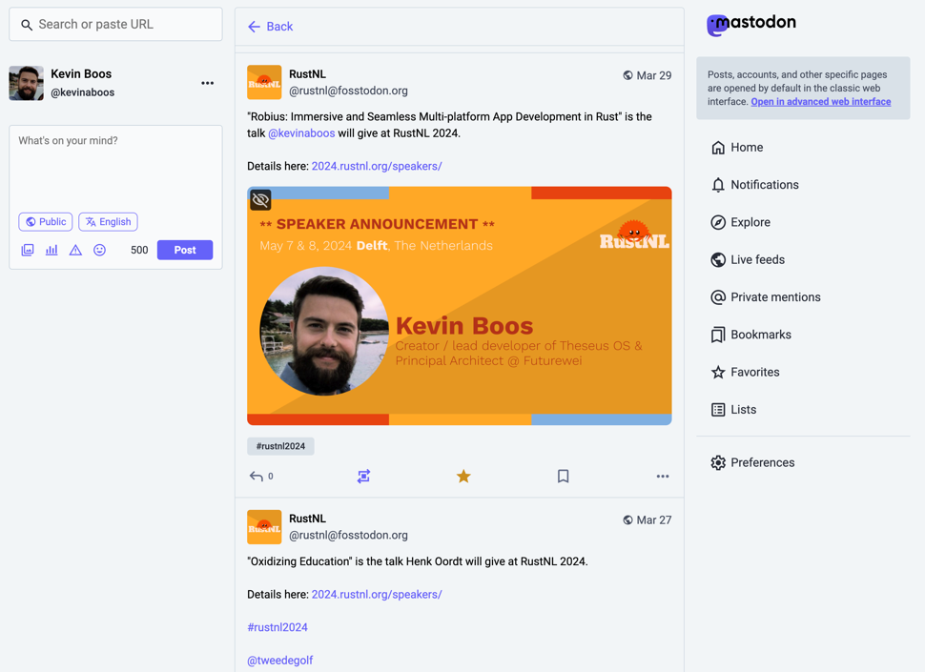
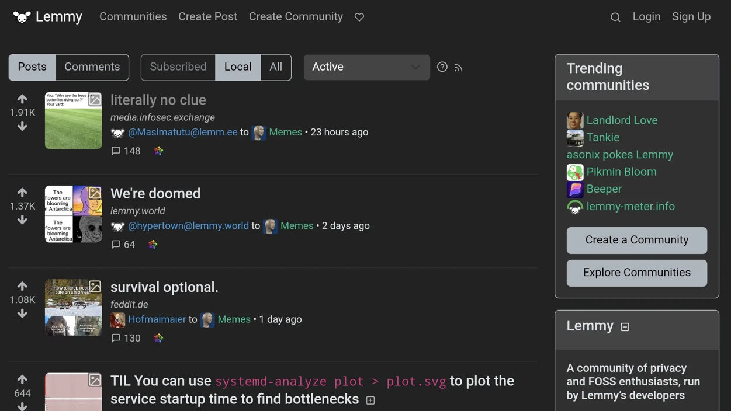
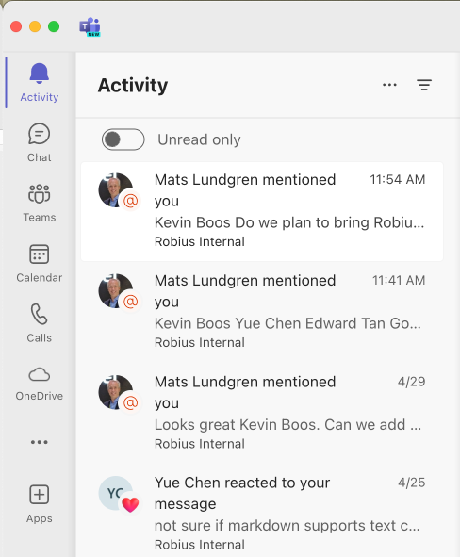
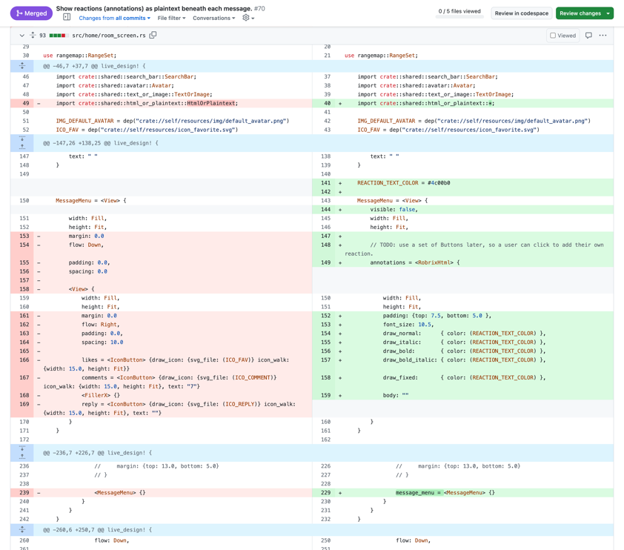
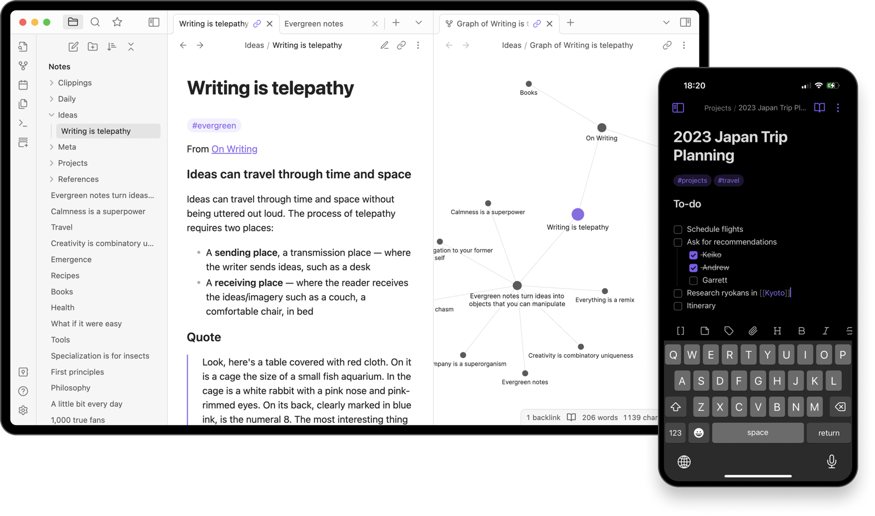
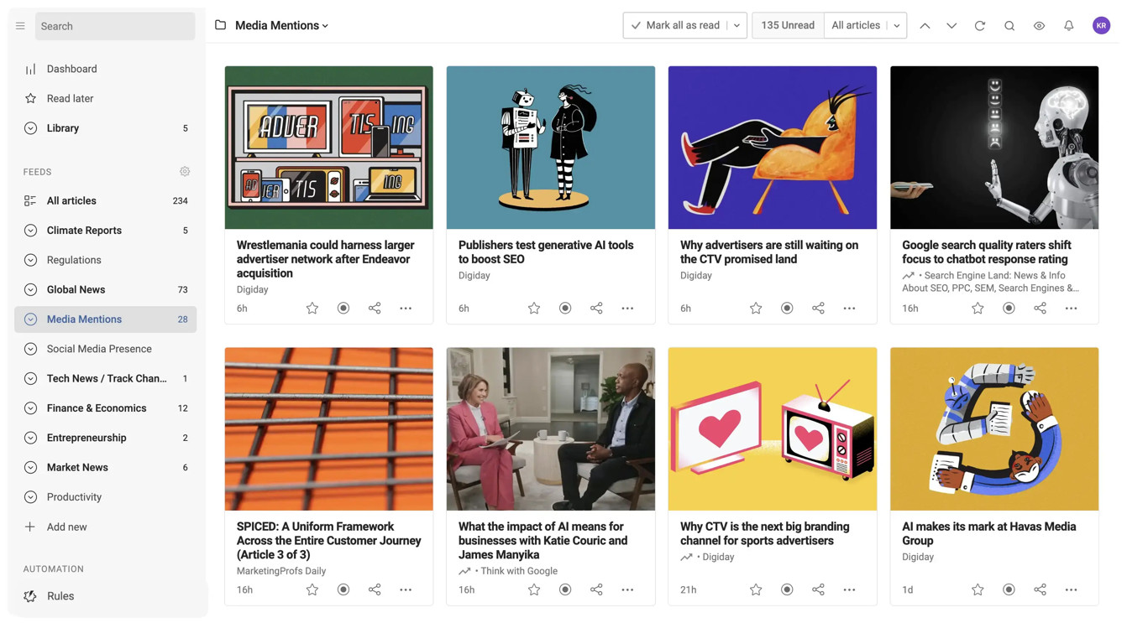
Stage 3 — a community hub (for open-source devs)
Chat (Matrix)
Microblogs (Mastodon)
Community Forums (Lemmy)
Notifications, activity pane
Code [re]view (git)
Notes
News feeds (RSS)
Notes:
This is the part of the talk that most relates to the concept of a next-gen internet.
We envision developing Robrix into a community hub app of sorts, that can collect multiple services: ActivityPub (Mastodon, lemmy, code/reviews (github)
→ All the stuff the open-source community wants, all in one place
----------------
0. Data sovereignty (a user owns their data, can host & manage it, exposed via common federated standard APIs)
1. Place to host code (Gitlab, Github, etc)
2. Place to host chat (Matrix, etc)
3. Place for announcements, micro-blogs (Mastodon, twitter, etc)
4. Place to collect notifications across multiple services (Github updates/following, username tags on GH/matrix/mastodon/etc, replies/DMs on matrix & mastodon,
5. Place to collect discussion forums
6. Place to show news feeds (RSS feeds, etc)
----- Extras: -----
7. Place to host and view notes (Obsidian, Evernote, Google keep, etc)
Potential for novel "combo" features: easily publish tweets/toots on Mastodon and Matrix posts about a GitHub release for your project

Slide 46


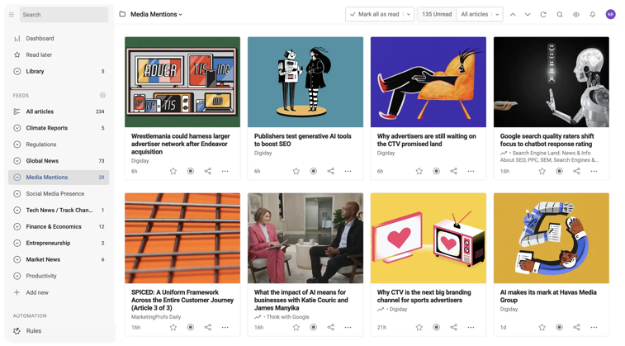

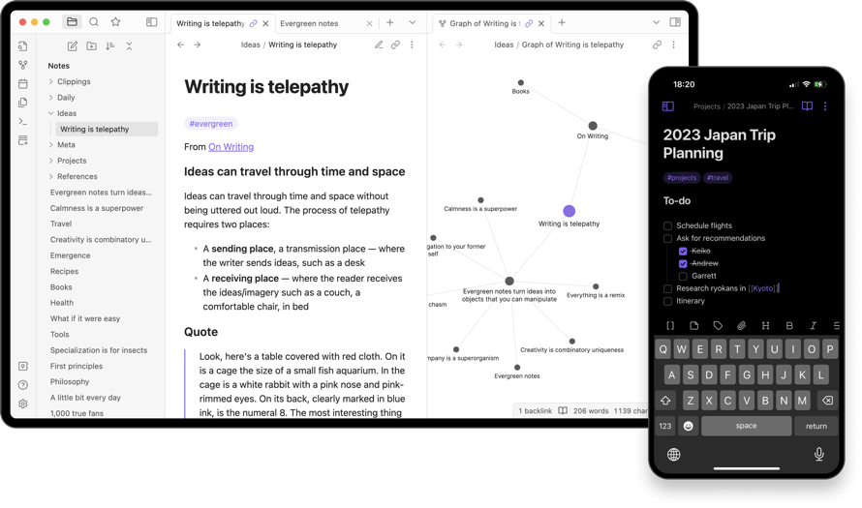
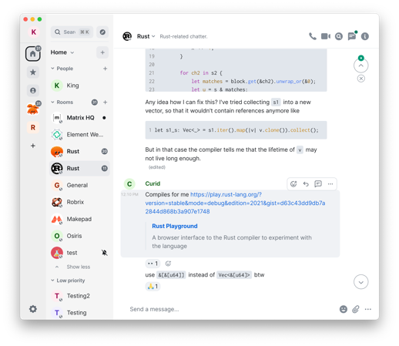
Collect multiple federated services in a single experience
robrix
Microblogs (Mastodon)
Community Forums (Lemmy)
News feeds (RSS)
Code [re]view (git)
Notes
Chat (Matrix)
Potential for powerful combo features & actions
Notes:
Collect multiple services: ActivityPub (Mastodon, lemmy, code/reviews (github)
Singular identity management via integration with Open Wallet Foundation
----------------
0. Data sovereignty (a user owns their data, can host & manage it, exposed via common federated standard APIs)
1. Place to host code (Gitlab, Github, etc)
2. Place to host chat (Matrix, etc)
3. Place for announcements, micro-blogs (Mastodon, twitter, etc)
4. Place to collect notifications across multiple services (Github updates/following, username tags on GH/matrix/mastodon/etc, replies/DMs on matrix & mastodon,
5. Place to collect discussion forums
6. Place to show news feeds (RSS feeds, etc)
----- Extras: -----
7. Place to host and view notes (Obsidian, Evernote, Google keep, etc)
8. micropayments as a financial "like" (kudos) that can be given for microblogs, release announcements, etc
Key feature: use an OpenWallet single sign-on for all of those services
Potential for novel "combo" features: easily publish tweets/toots on Mastodon and Matrix posts about a GitHub release for your project (then collect financial kudos on any of the three -- see below)

Slide 47

Identity mgmt. via OpenWallet
robrix
Decentralized ID provider
[long-term] integrate into Matrix specification
Notes:
Singular identity management via integration with Open Wallet Foundation’s work
Robrix can act as a bridge to streamline identity management across many different services, but we will start with Matrix
We hope to integrate OpenWallet into the actual Matrix spec in order to provide a working initial implementation, which is required as part of Matrix’s spec proposal and RFC process
But at first, Robrix will act as the experimental testing grounds for bootstrapping OpenWallet as an identity provider.
If we can integrate this with Matrix’s new MAS architecture (the Matrix Authentication Service), then using a local self-managed wallet to own and provide your identity could be as easy as logging in with SSO like google, apple, etc
Potential for novel "combo" features: easily publish tweets/toots on Mastodon and Matrix posts about a GitHub release for your project (then collect financial kudos on any of the three -- see below)

Slide 48
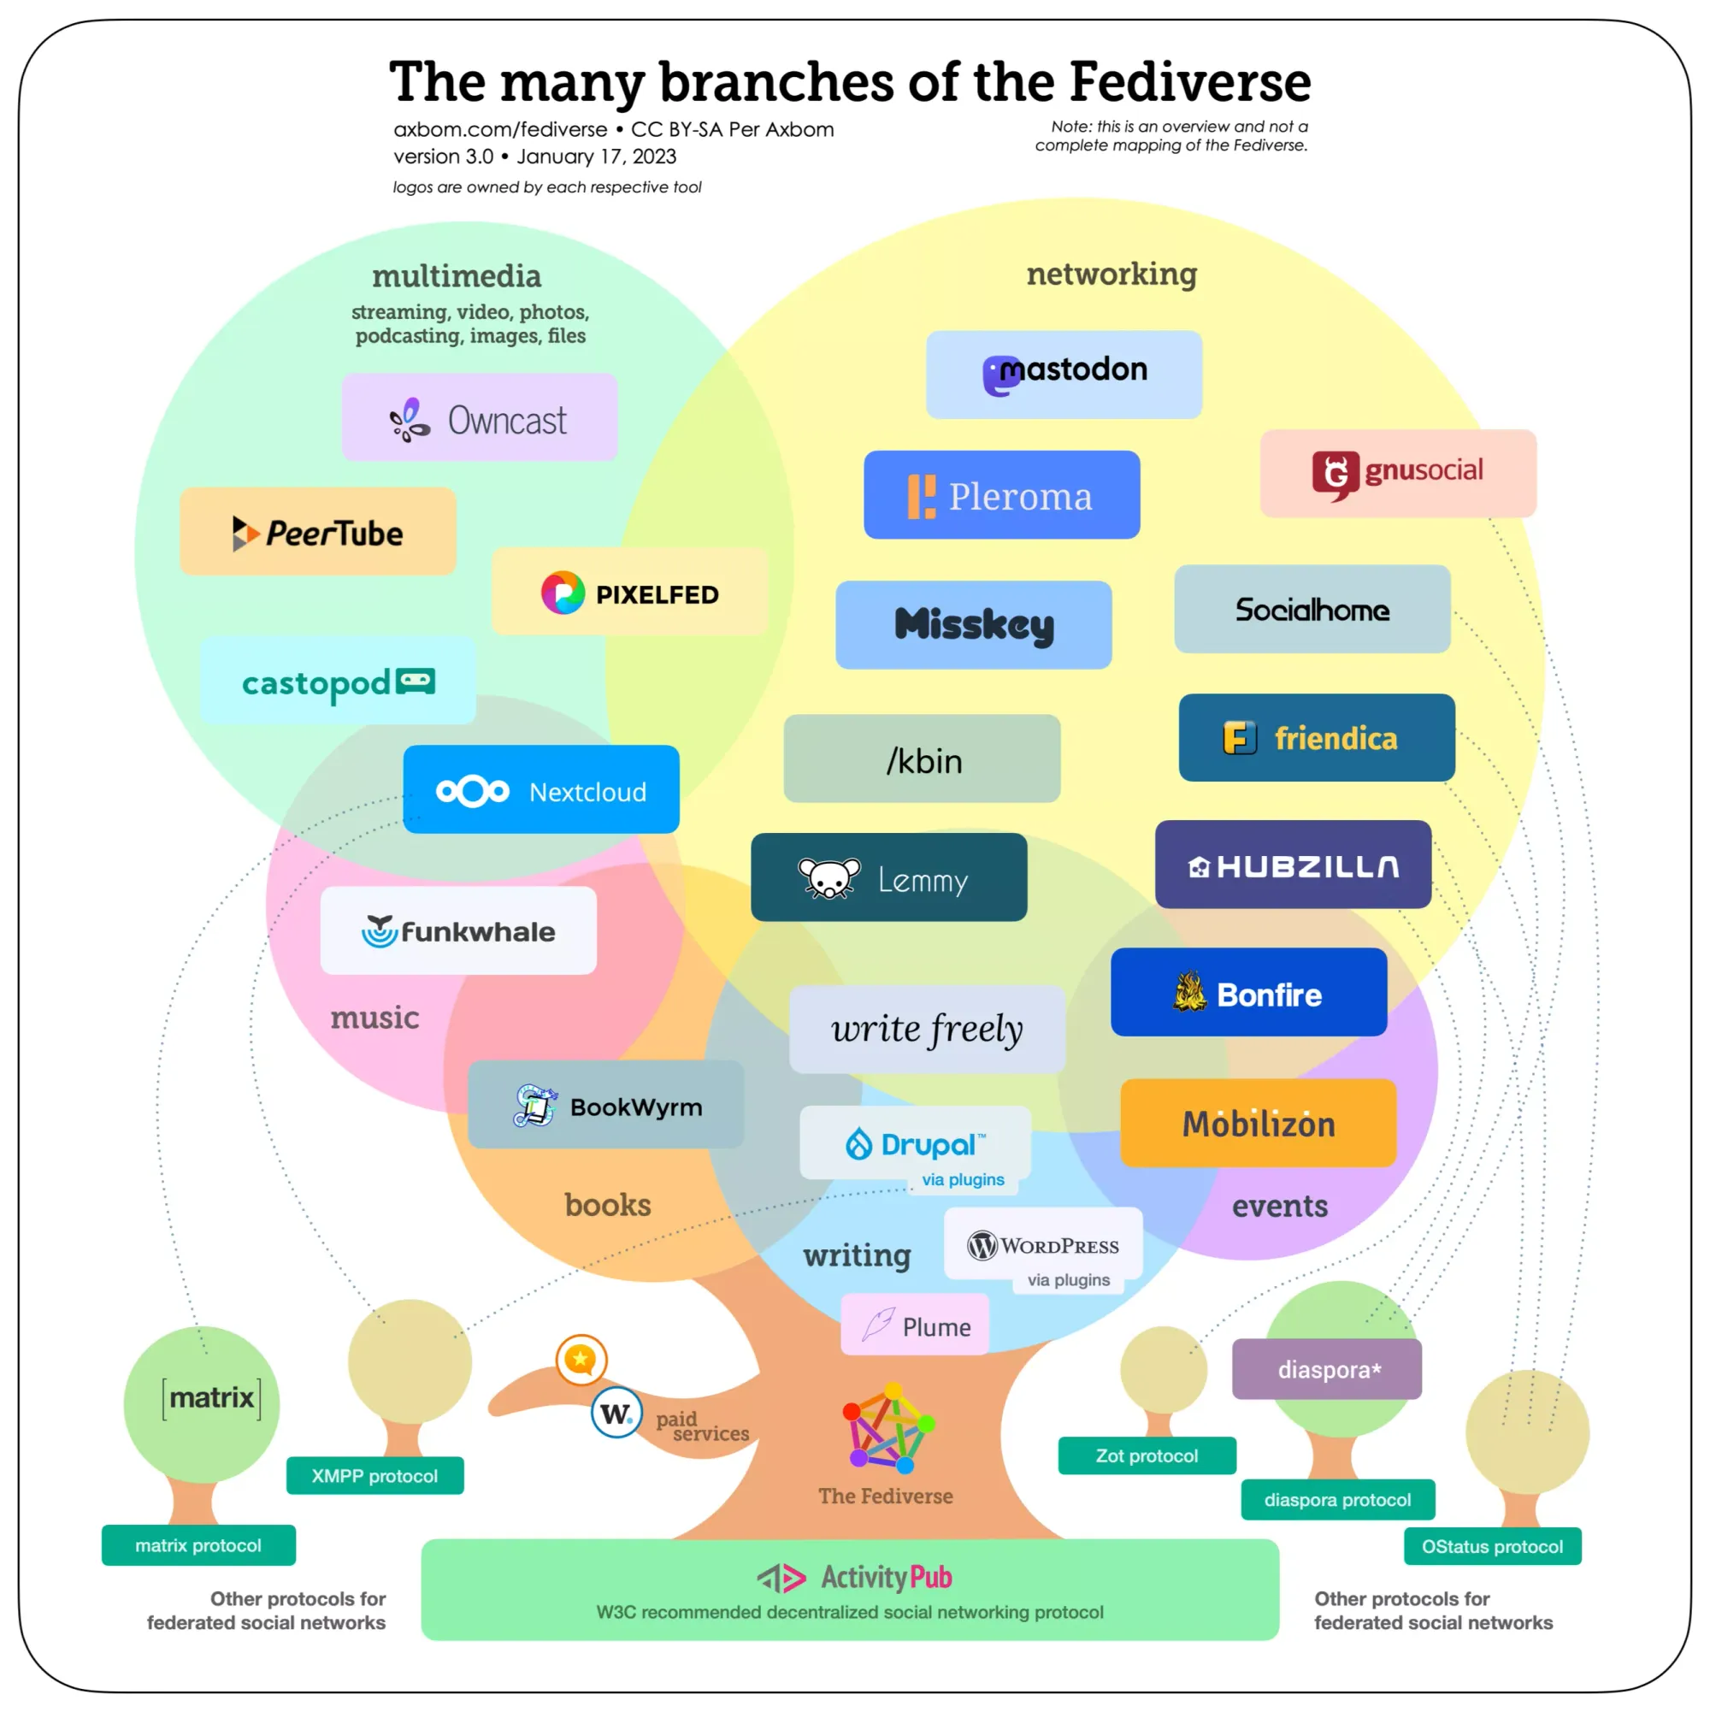
Many other service categories exist
Most based on ActivityPub
Image sharing | Pixelfed
Music sharing | Funkwhale
Podcasting | Castopod
Video hosting | PeerTube
Full blogging | Wordpress, Plume, etc.

Slide 49
make it easier to use & discover decentralized/federated services
49
Notes:
We hope that with these additions, Robrix will make it easier and more inviting to use and discover the vast array of federated services out there across the internet.

Slide 50







Acknowledgments
Rik Arends
Eddy Bruël
Edward Tan
Julian Montes de Oca
Jorge Bejar
Klim Tsoutsman
Sebastian Michailidis

Slide 51






Interested? Find us here:
@project-robius/robrix
@kevinaboos
#robius@matrix.org #robrix@matrix.org

